Slide 1

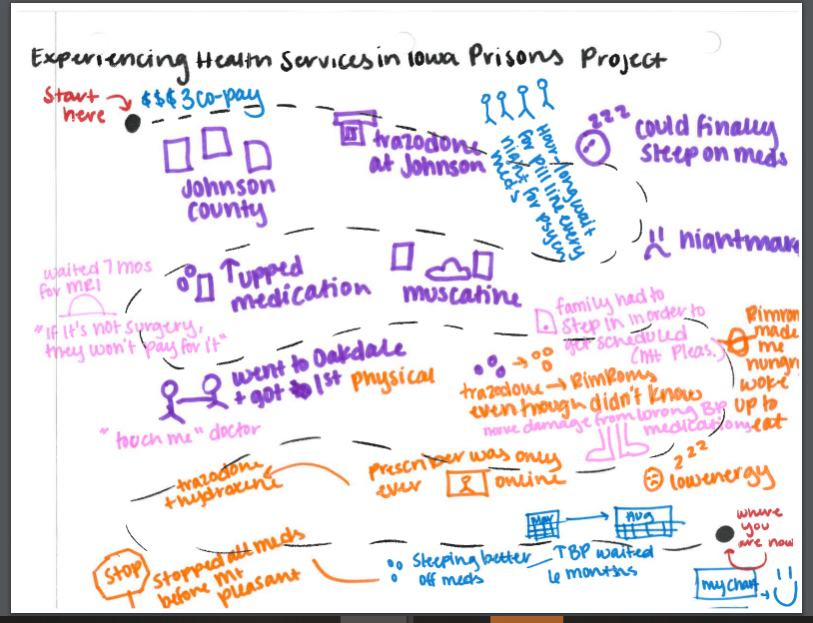
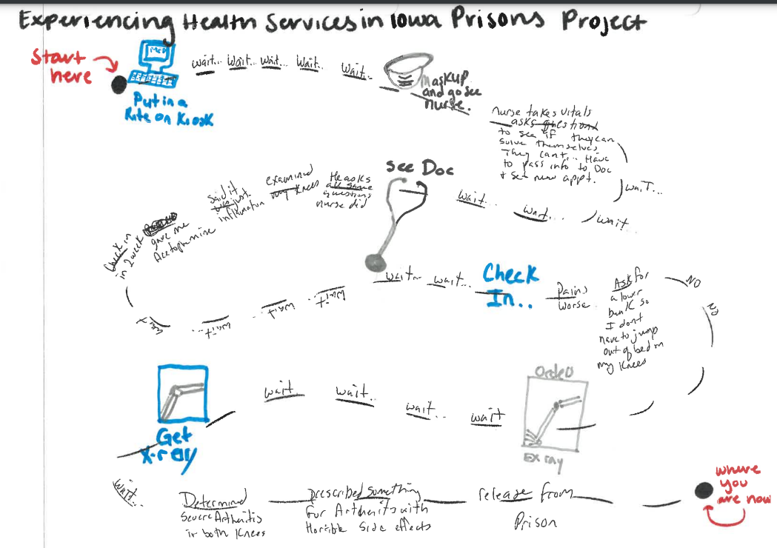
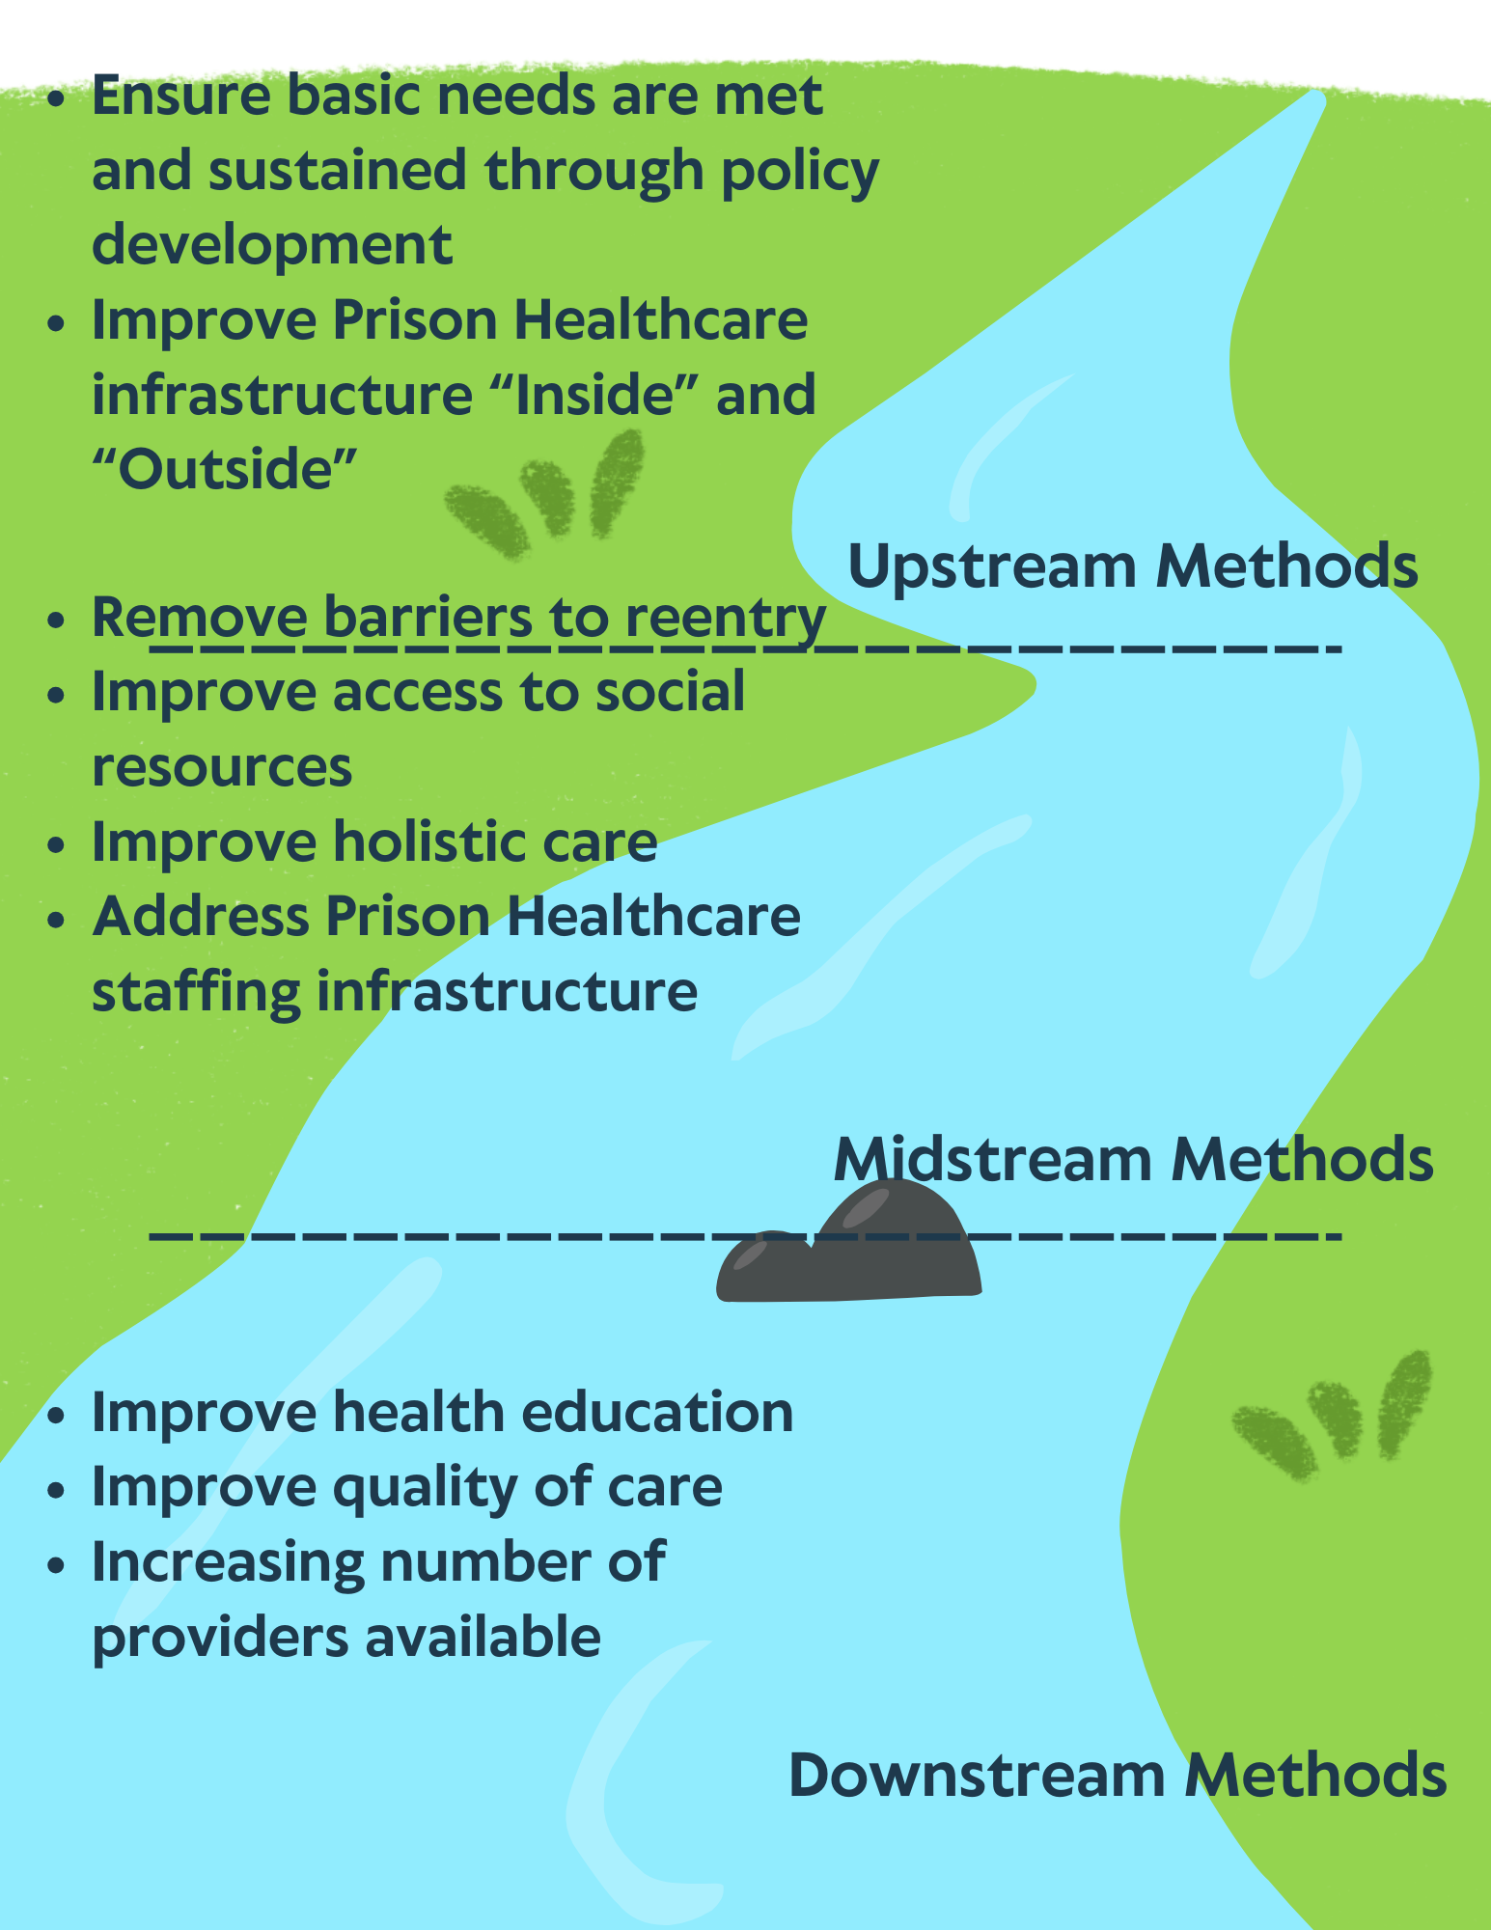
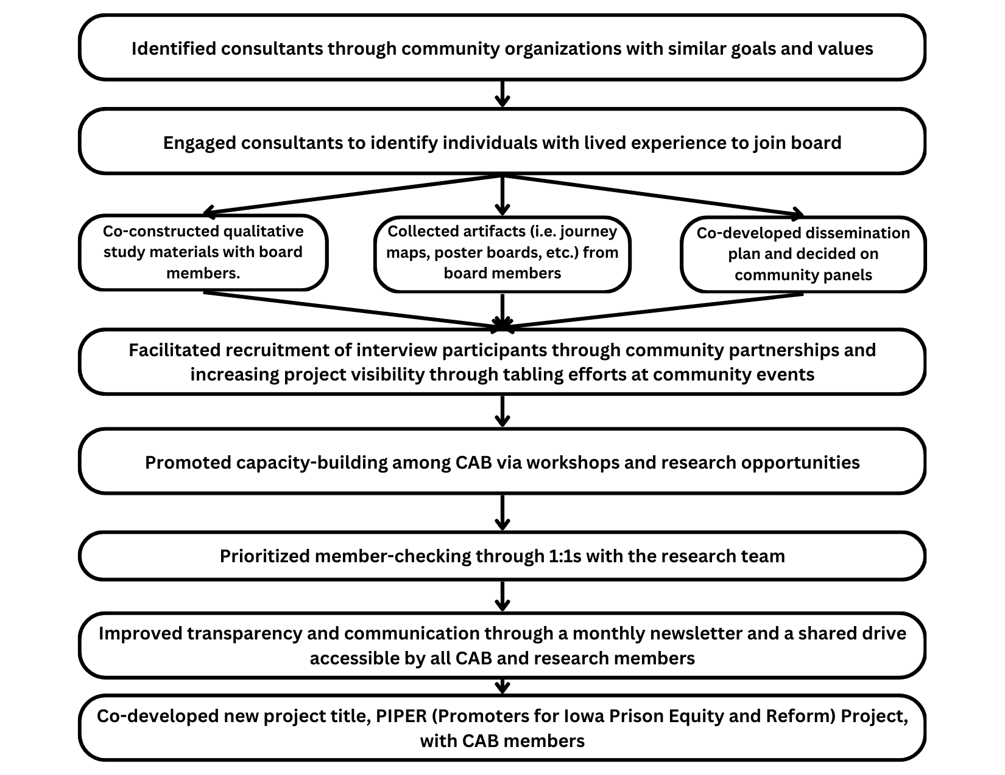
Experiencing healthcare in Iowa prisons: Mobilizing formerly incarcerated persons to understand and advocate for improvement in healthcare delivery and outcomes
Eboneé T. Johnson, Ph.D.^{1;} Amber M. Hawkins, MPH¹; Heather Erwin, Ph.D., J.D.²; Daria Fisher-Page, J.D.¹; Johnny “Dell” Pippins, M.S.¹;
Makayla Morales, MPH¹; Joshua Gillette³; Ryan Mckelvey³; Ken Greene³; Victor Hall, Sr.³; Thaddeus Wood³; Joshua Wages³;
Helen Neumann, M.A., LMHC³; Zachary Palmer³; Josie Pursley⁴; Gregory Lovett³; Randall Grandstaff³; Christopher Martin³; Jason Albaugh³
Introduction
Background Emerging evidence shows formerly incarcerated individuals experience long-term post-release health consequences due to substandard healthcare during their sentence.^{1, 2} However, limited data exists describing the diagnosis, treatment, and long-term care available to individuals in Iowa prisons. We aim to categorize and describe the experiences of individuals navigating Iowa’s prison healthcare system through 12 semi-structured qualitative interviews. Methods and Data Collection Utilized participatory action research approach with construction of interview guide and dissemination protocol. Recruitment materials shared with local organizations Community advisory board (CAB) directly shared materials with potentially eligible community members. Identified interview participants and conducted interviews Collaboratively analyzed interview data and artifacts. Developing and engaging community advisory board We aim to center and elevate the voices of our CAB members during the research process in an iterative way. Full CAB feedback was collected and implemented at each stage.
Emerging Results
Discussion
Recommendations Need to move upstream to inform practice, research, and policy.³ Engaging community members enriches the scope and impact of research, especially formerly incarcerated populations
Community advisory board members developed journey maps to describe their experiences navigating the healthcare system in Iowa prisons.
Thematic Analysis
Seven key themes were identified in preliminary analysis of interview data and community advisory board’s lived experience.
Theme Exemplar Quote
Community Advisory Board Member Reflections
Substandard dental care | "My teeth were bad because of drug use... When I saw the dentist, he said 'pick one tooth', because they weren't going to treat all of them."
Perceived medication mismanagement | "They give you a pill to make you quiet and go away." "The 'pill line' is everyone in the prison... because of overpopulation, they want to sedate as many people as possible."
Medical negligence | "You have a problem and get sent to [external hospital], where they prescribe you one thing, but then give you something else when you get back to the prison."
Health and well-being | “...become a number now” "If I could have prioritized my mental health when I was in the first time, I wouldn't have gotten back on the drugs and ended up right back inside."
Participants’ Reflections
Quality of care | "Medicine zombified me" "Feeling misdiagnosed... don't know who to ask"
Lack of accountability | "Shifting the blame" "Cannot appeal to state for medical negligence"
Mental health and well-being | "Feel more institutionalized" "Always something running against me" "Can't shop around [for providers] in jail"
References
Ahalt, C., Trestman, R. L., Rich, J. D., Greifinger, R. B., & Williams, B. A. (2013). Paying the price: The pressing need for quality, cost, and outcomes data to improve correctional health care for older prisoners. Journal of the American Geriatrics Society, 61(11), 2013-2019.
Blackaby, J., Byrne, J., Bellass, S., Canvin, K., & Foy, R. (2023). Interventions to improve the implementation of evidence-based healthcare in prisons: A scoping review. Health & Justice, 11(1), 1.
Williams, D. R., Costa, M. V., Odunlami, A. O., & Mohammed, S. A. (2008). Moving upstream: how interventions that address the social determinants of health can improve health and reduce disparities. Journal of Public Health Management and Practice, 14(6), S8-S17.
Acknowledgements
Funding for this project provided by the University of Iowa’s Office of Vice President for Research: Community Engaged Scholars Program as a part of the Research Development Office’s Seeding Excellence Initiative and the University of Iowa’s College of Public Health
We are thankful for the time, commitment, transparency, expertise, and vulnerability of all research consultants, collaborators, and participants.
We would like to thank Christopher Veeh, Ph.D. for his consultation and support.

