Slide 1

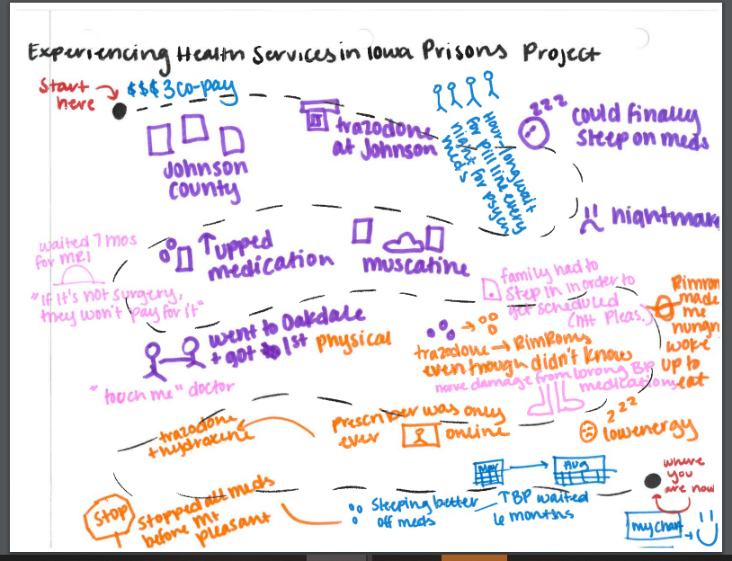
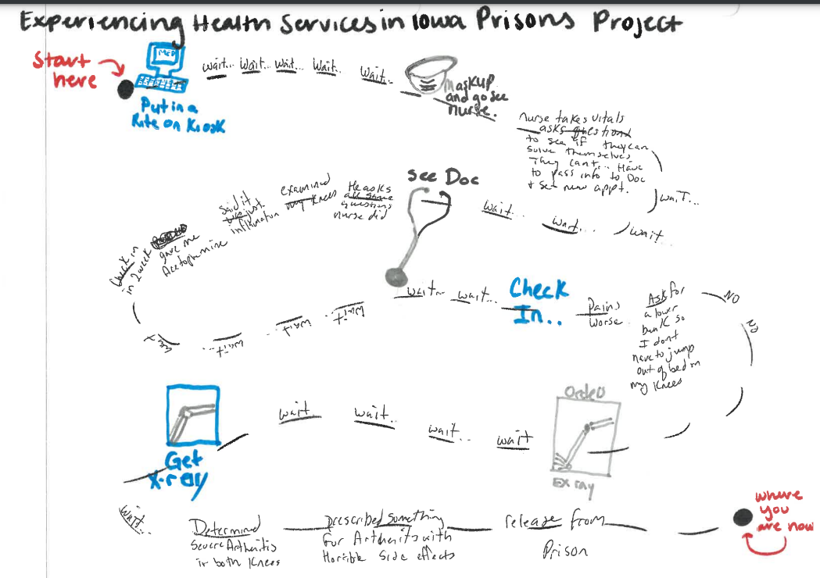
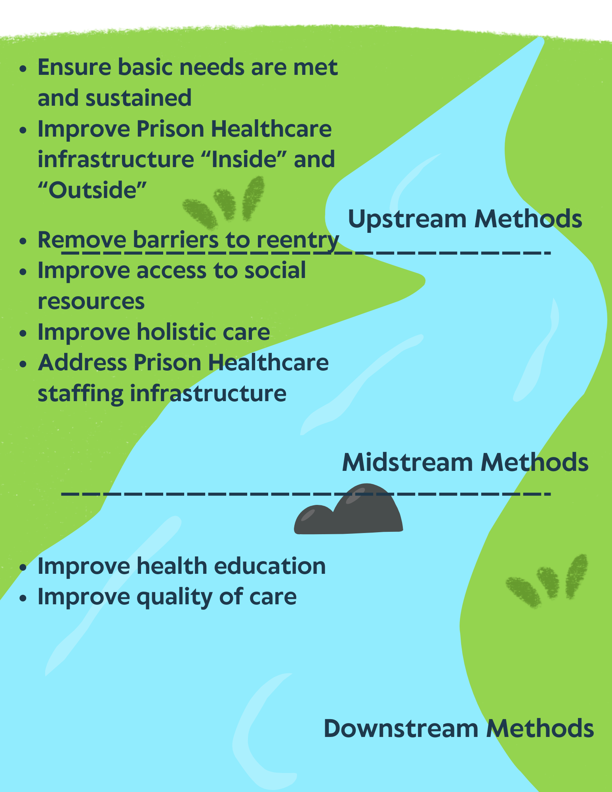
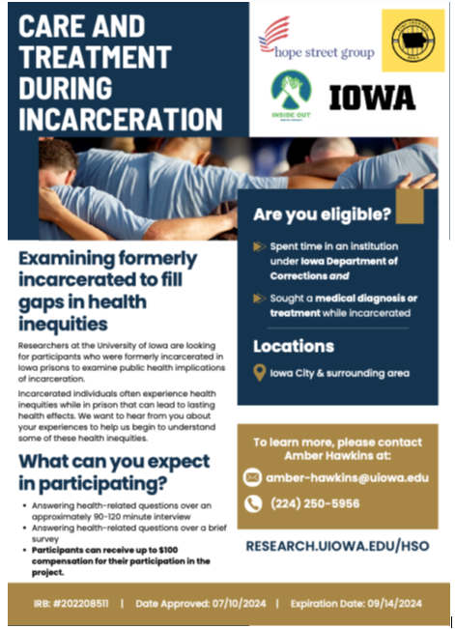
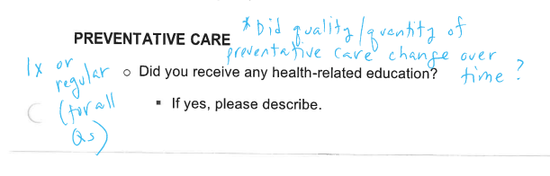
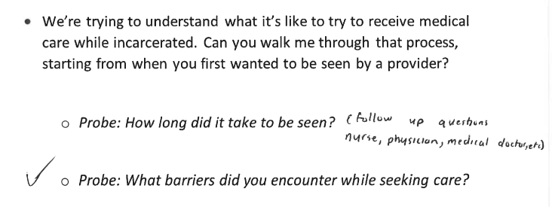
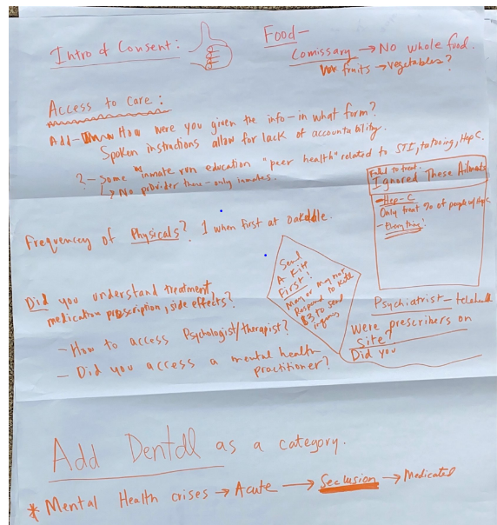
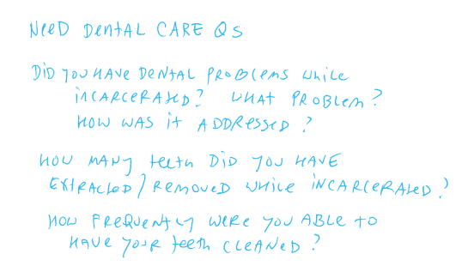
Experiencing Healthcare Systems in Iowa Prisons
Eboneé T. Johnson, Ph.D.; Amber M. Hawkins, MPH; Makayla Morales, MPH; Dell Pippins; Heather Erwin, JD; Daria Fisher-Page, JD
Jason Lewis Albaugh, Randall Grandstaff, Joshua Gillette, Ken Greene, Victor Hall, Sr.,
Gregory Lovett, Christopher Martin, Helen Neumann, Zachary Palmer, Josie Pursley, Joshua Wages and Thaddeous Wood
Introduction
Emerging Results
Discussion
Need to Move Upstream to Inform Practice, Research, and Policy³
Health is a fundamental human right; however, evidence shows formerly incarcerated individuals experience long-term post-release health consequences due to substandard healthcare during their sentence. ^{1, 2}
Purpose
What are the experiences of individuals as they navigate Iowa’s prison healthcare system?
Methods
Participatory action research approach Recruit and convene community advisory board/research consultants Document lived experience from the lens of board, consultants, and collaborators Co-construct research protocols Iterative process of data collection and analysis
Thematic Analysis
Theme Exemplar Quote
Board Member Reflections
Process of Seeking and Gaining Care | “red tape” “proper channels”
Communication | “right arm doesn’t know what the left is doing” “horrible communication”
Mental Health and Well-being | “not going to bend over backwards to be sure you are mentally good”
Dehumanization | “become a number now”
Quality of Life | “quality of life takes a dive” “can do a lot while in pain”
Participants’ Reflections
Quality of Care | "Medicine zombified me" "Feeling misdiagnosed... don't know who to ask"
Lack of Accountability | "Shifting the blame" "Cannot appeal to state for medical negligence"
Mental Health and Well-being | "Feel more institutionalized" "Always something running against me" "Can't shop around [for providers] in jail"
Feedback on survey and interview guide
Data Collection
References
Board Members and Consultants | Participants
6 Board Meetings June 2024-Ongoing Feedback on study materials, such as recruitment flyers, pre-interview surveys, and semi-structured interview protocols Artifacts such as poster boards, journey maps, and illustrations | 2 Pre-interview Surveys collected 1 Semi-Structured Interview completed 4 participants screened; field notes collected during screening process
Ahalt, C., Trestman, R. L., Rich, J. D., Greifinger, R. B., & Williams, B. A. (2013). Paying the price: The pressing need for quality, cost, and outcomes data to improve correctional health care for older prisoners. Journal of the American Geriatrics Society, 61(11), 2013-2019.
Blackaby, J., Byrne, J., Bellass, S., Canvin, K., & Foy, R. (2023). Interventions to improve the implementation of evidence-based healthcare in prisons: A scoping review. Health & Justice, 11(1), 1.
Williams, D. R., Costa, M. V., Odunlami, A. O., & Mohammed, S. A. (2008). Moving upstream: how interventions that address the social determinants of health can improve health and reduce disparities. Journal of Public Health Management and Practice, 14(6), S8-S17.
Significant differences in Healthcare Experiences : “Inside” and “Outside”
Care received "inside" can impact health and well-being "outside"
Lessons Learned
"Sedates rather than rehabilitates"
Loss of autonomy for incarcerated folks and complete lack of accountability... "Becoming a ward of the state"
Acknowledgements
Funding for this project provided by the University of Iowa’s Office of Vice President for Research: Community Engaged Scholars Program as a part of the Research Development Office’s Seeding Excellence Initiative and UI College of Public Health
We are thankful for the time, commitment, transparency, and vulnerability of all research consultants and participants.

