Slide 1
““We have to do better”: Advocating to improve the mental health infrastructure in Iowa’s prisons
10.15.25

Slide 2
Agenda
Overview of PIPER Project
Moderated Panel Discussion
Reflective Comments from the Audience/Question & Answer

Slide 3
Promoters for Prison Empowerment and Reform (PIPER) Project

Slide 4
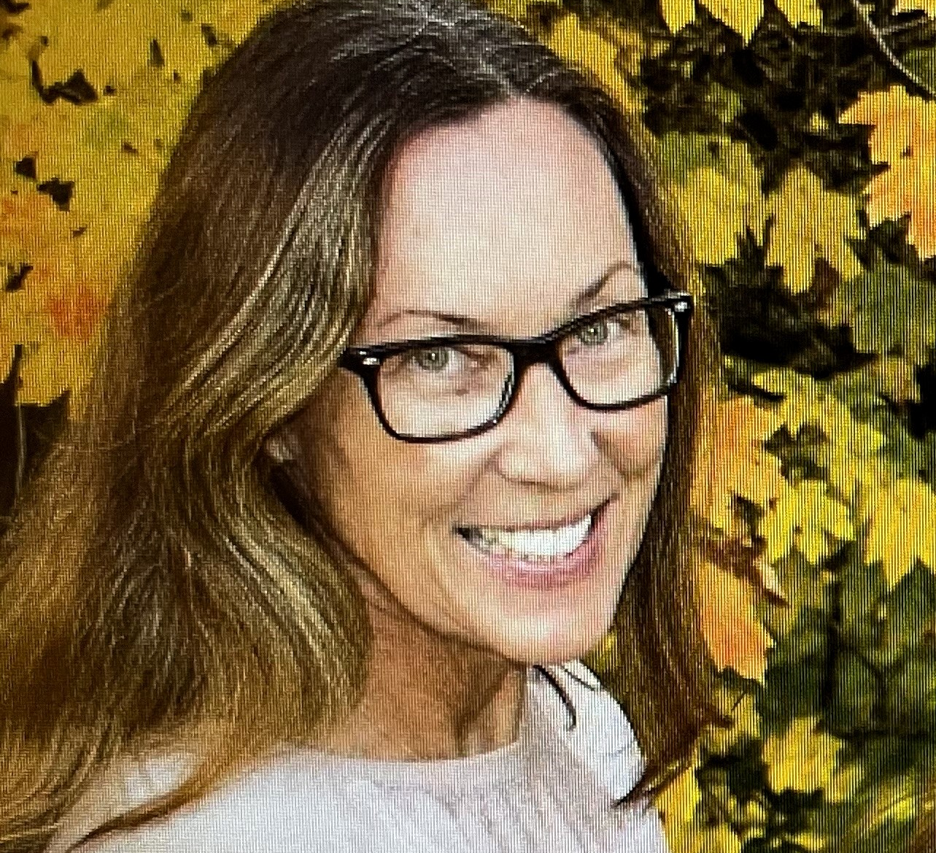
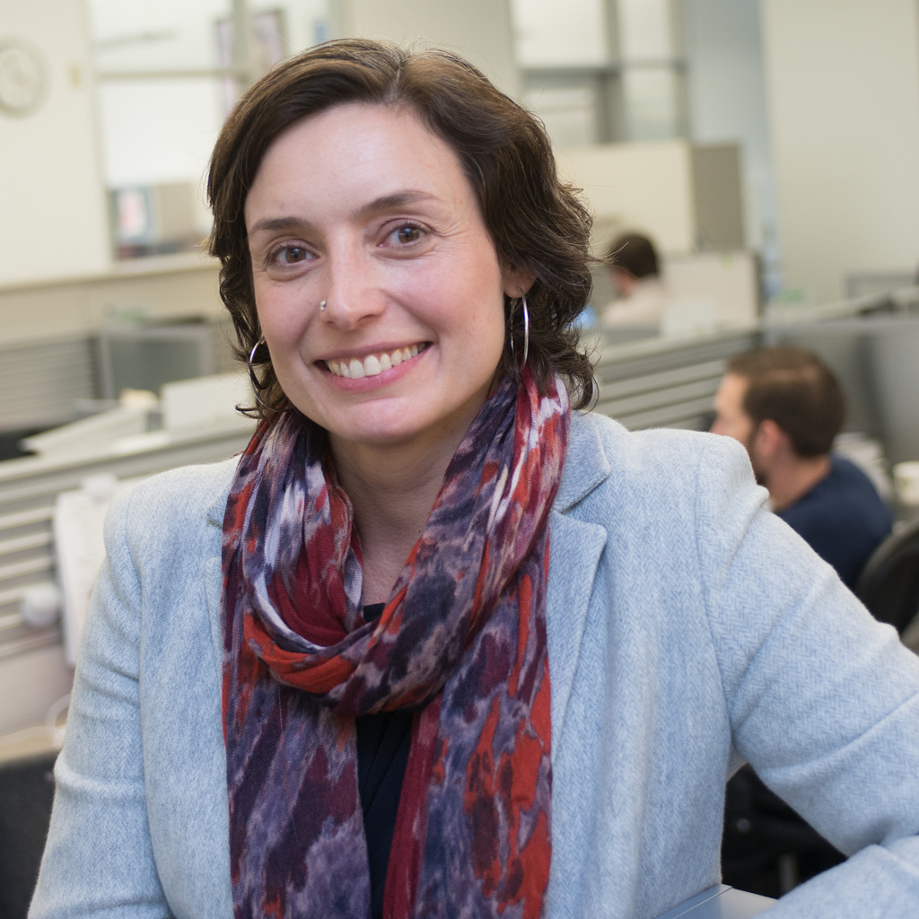
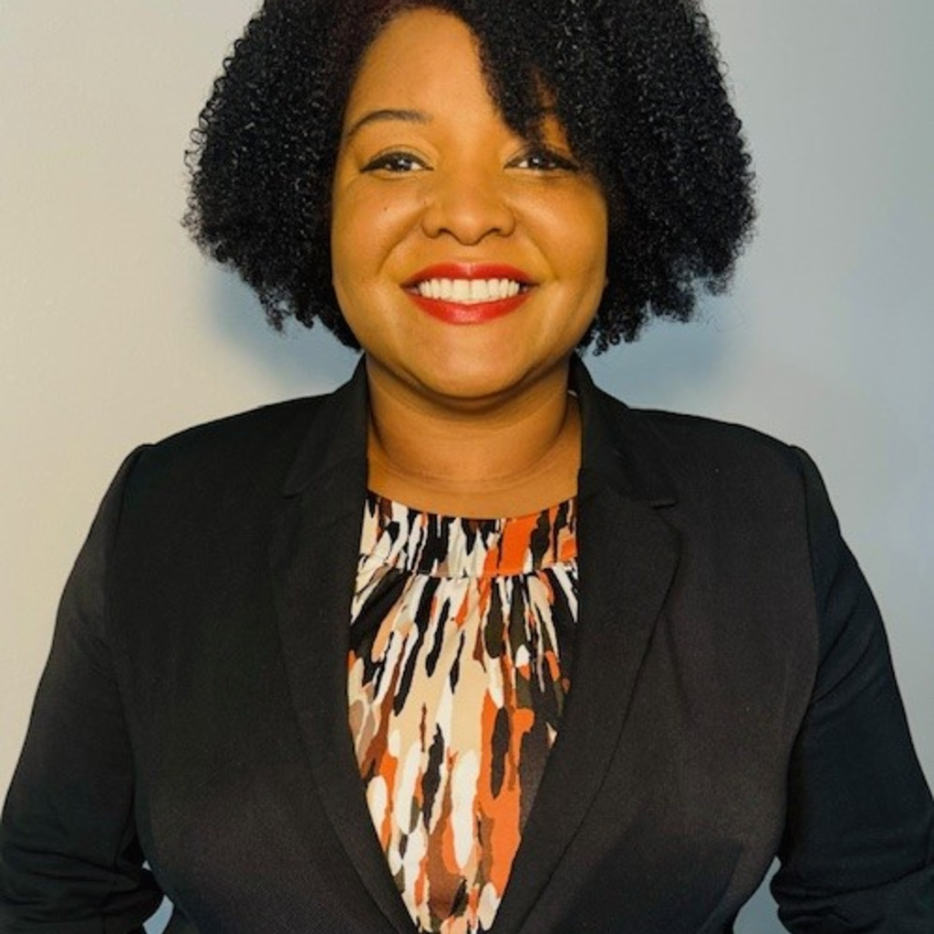
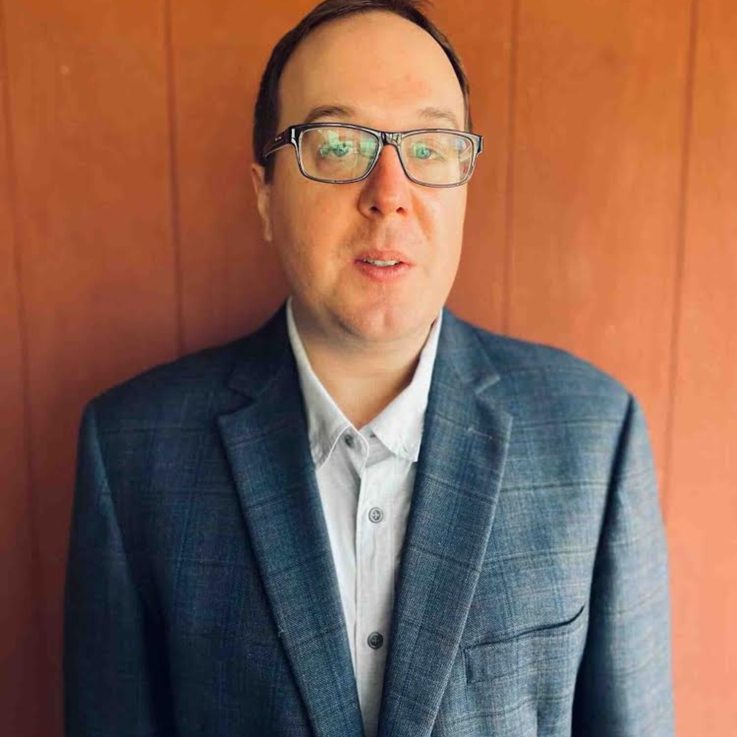
Leadership Team
Heather Erwin, Ph.D., J.D.
Adjunct Faculty, Sociology and Criminology
Daria Fisher-Page, J.D.
Associate Dean, College of Law
Eboneé T. Johnson, Ph.D.
Assistant Professor of Community & Behavioral Health, College of Public Health
Christopher Veeh, Ph.D.
Associate Professor of Social Work, College of Liberal Arts and Sciences

Slide 5
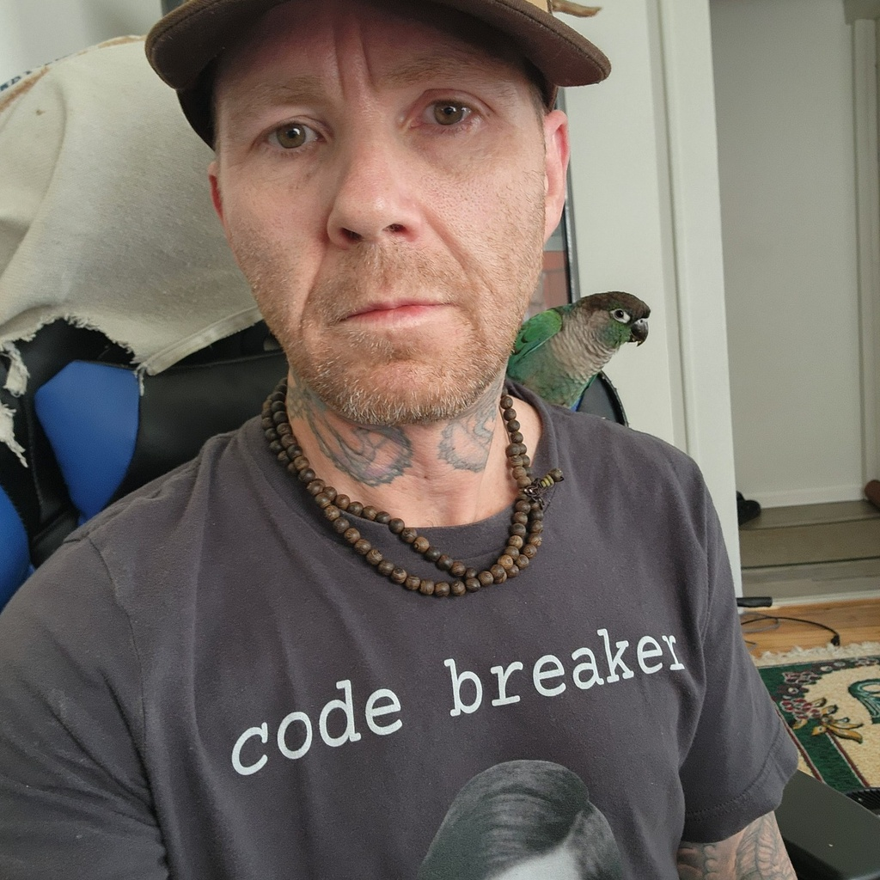
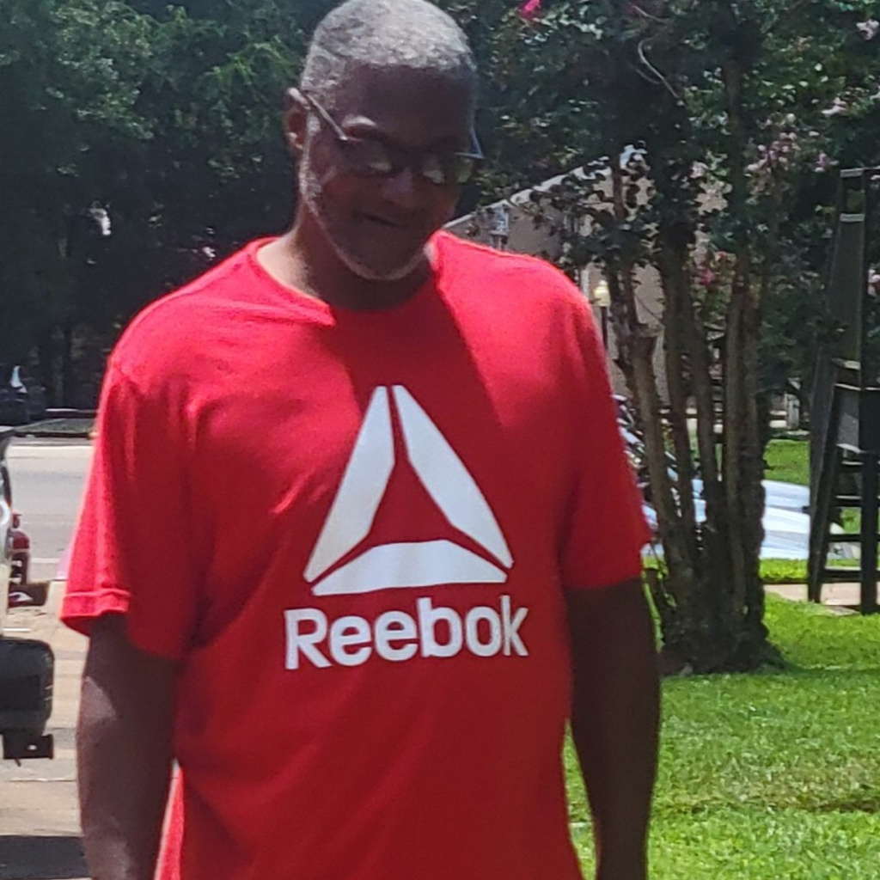
2025-2026 Featured Panelists and Advisory Consultants
Joshua Gillette
UI Alum
Business Owner
2022-Current
Ken Greene
Peer Recovery Coach
Abbe Mental Health Center
2024-Current
Randall Grandstaff
Gregory Lovett
Joshua Wages

Slide 6
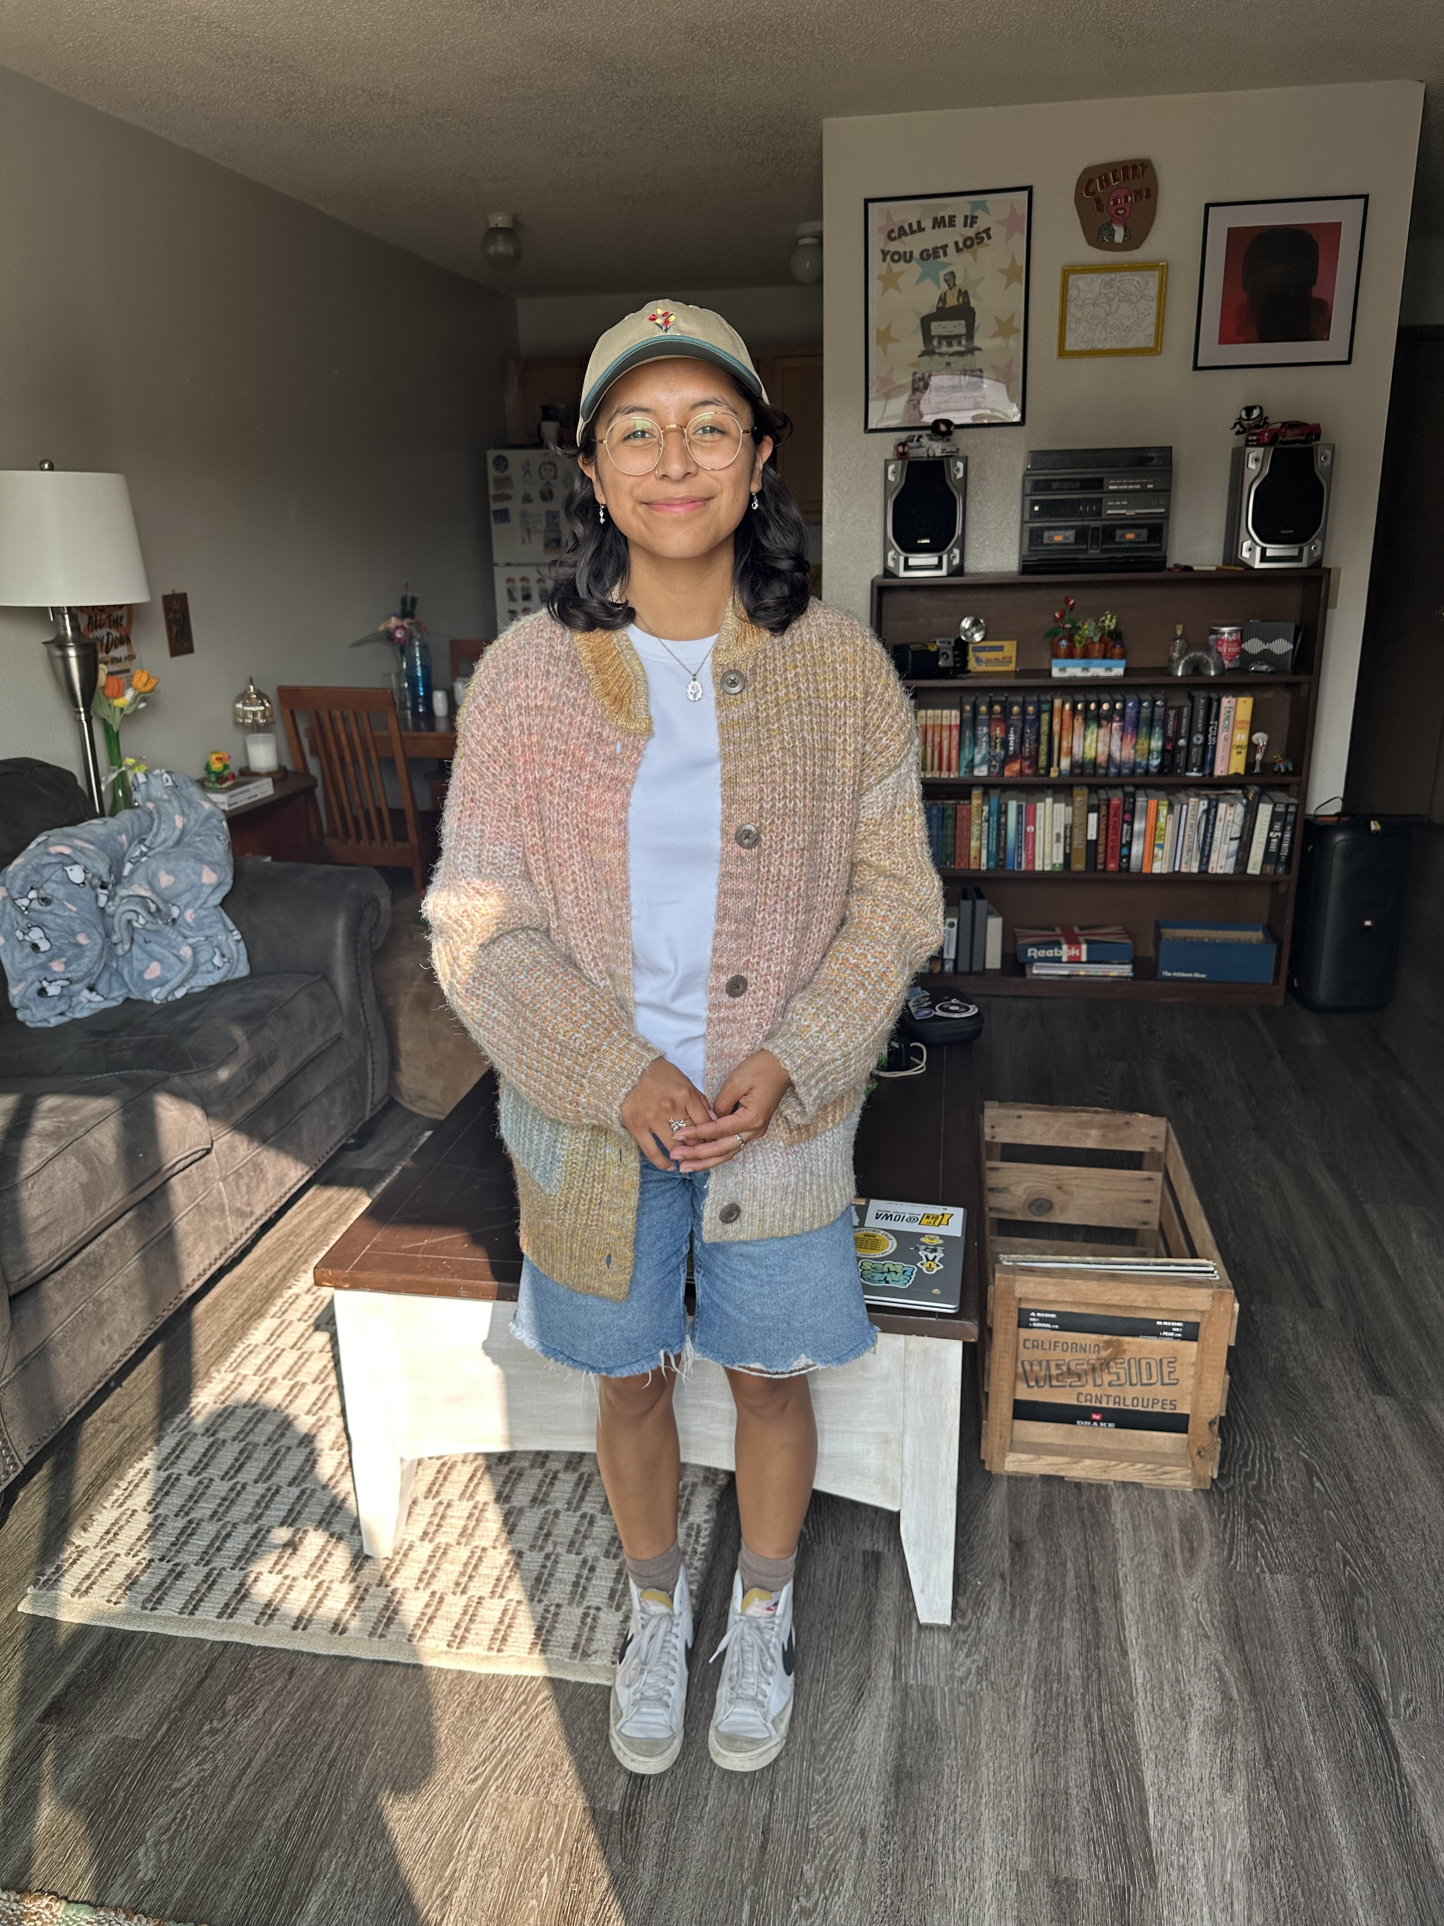
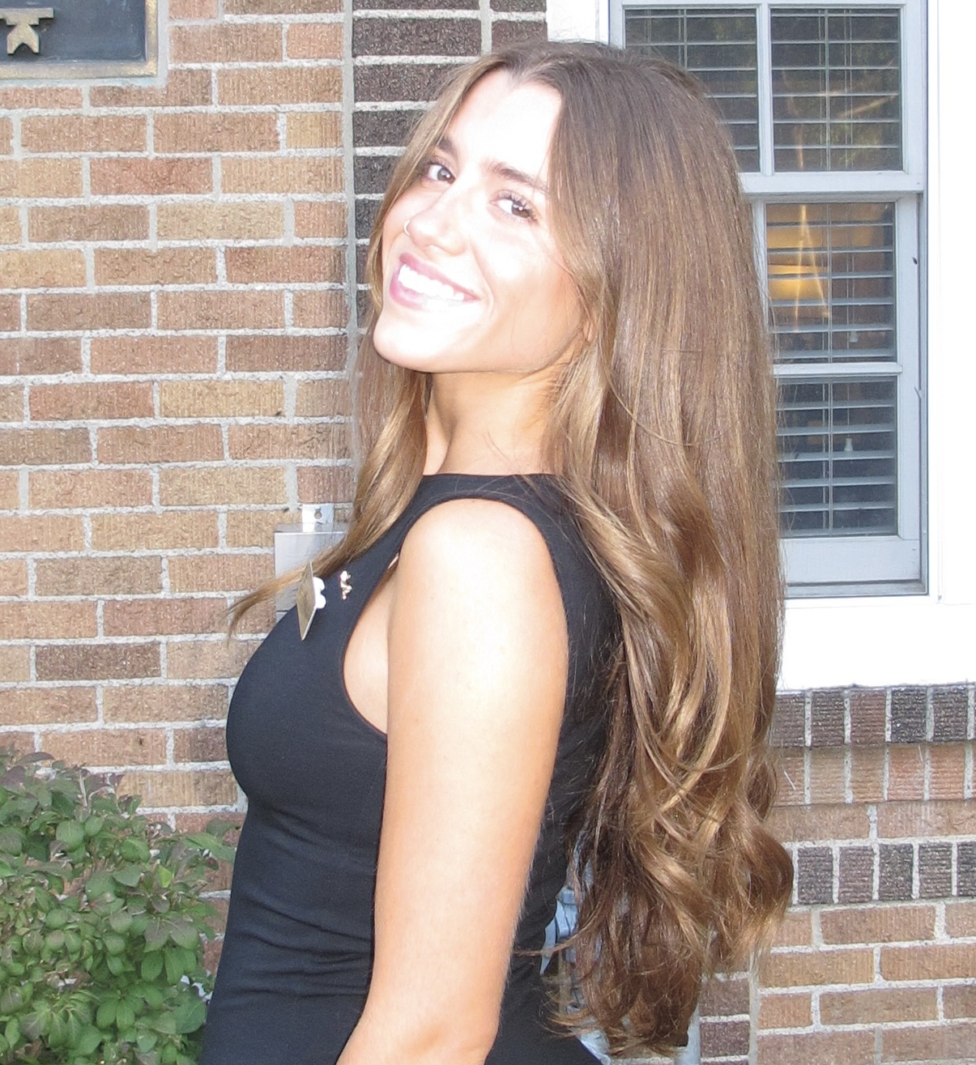
2025-2026 Undergraduate Research Assistants
Aphraditie Hancock
Phoebe Guido
Public Health and Social Work
Undergraduate Student
Criminology and Psychology Undergraduate Student

Slide 7
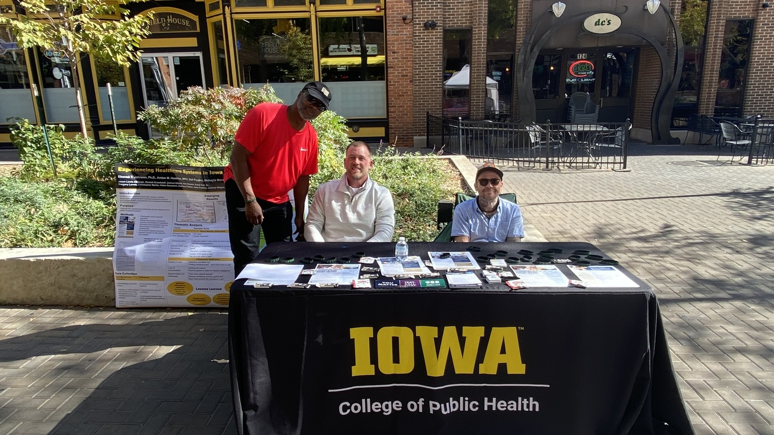
Goal
To better understand how people navigate prison healthcare systems, how they perceive the quality of care received, and how incarceration has shaped their ongoing health.

Slide 8
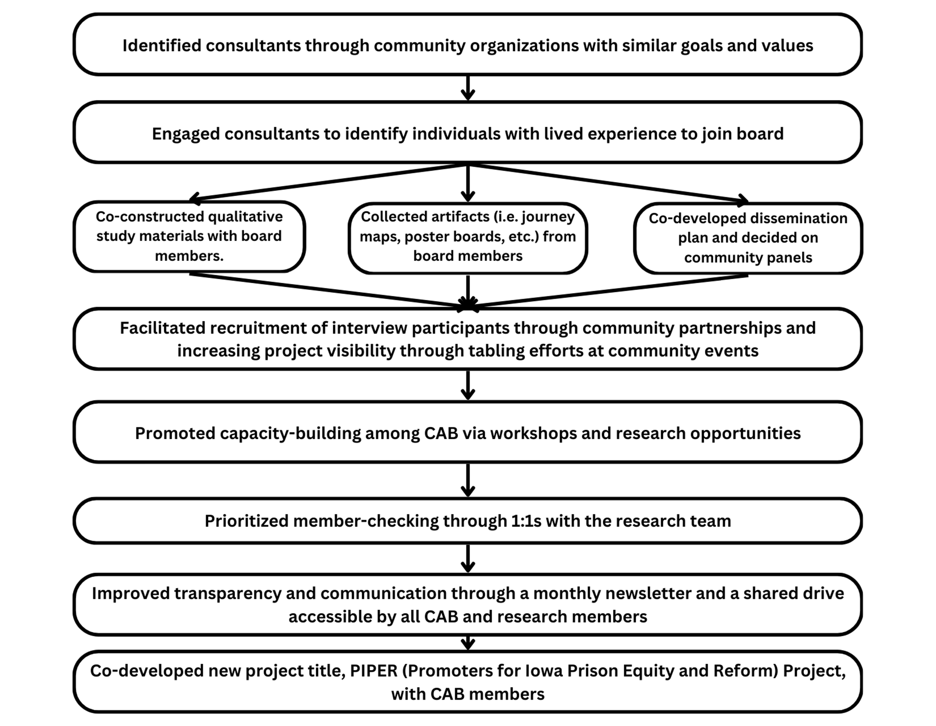
Participatory Action Approach

Slide 9
Lessons Learned: Qualitative Study
Reflexive Thematic Analysis
Lasting Carceral Impact
Ineffective Treatment and Care
Carceral Catalysts and Constraints
Reframing Recreation: From Privilege to Promoting Health

Slide 10
Panel Discussion

Slide 11
Reflections I
What exposure to mental health services did you have prior to incarceration?
Notes:
For Josh and Ken

Slide 12
Reflections II
One of our research participants stated:
“The Department of Corrections is not into preventative care; it's more into reactive care.”
Reflecting on this quote,
What kind of mental health services did you or your peers have access to while incarcerated?
What else would have been helpful?
Notes:
For Josh and Ken

Slide 13
Reflections III
How are peer support networks currently working in carceral settings?
Notes:
For Ken

Slide 14
Reflections IV
What recommendations do you have to improve current mental health services in carceral settings?
Notes:
What 1-2 recommendations do you have to improve current mental services in prison? practice and policy??????
All panelists
Peer support,
Telehealth meetings with community service providers (MH and/or SUD) or even co-location of service providers (based on location limitations) to establish a seamless transition plan from the facility back into the community that can help establish access to needed medications and a pre-existing therapeutic relationship with a local service provider
In tandem with more formalized relationships with service providers, advocate for a Medicaid Section 1115 waiver for individuals transitioning from incarceration that meet criteria for a MH disorder or SUD. 19 states (for example: Arizona, California, New Mexico, Kentucky, West Virginia, Michigan, Colorado, Vermont, etc) have received approval for a waiver allowing individuals leaving correctional institutions to immediately access MAT, counseling, SUD treatment, MH medication, physical exams, as well as other services via Medicaid (KFF, 2025).
Iowa has not pursued any change to Medicaid eligibility for the formerly incarcerated. Iowa has only requested a Section 1115 waiver to add work requirements for Medicaid eligibility.
behavioral health literacy (ecosystem)
Interventions should push to think with a systems focus that address the entire ecosystem of stakeholders within a correctional system - to promote the well-being of individuals during incarceration, we need to make sure we are also thinking about improving the well-being of those working directly with the incarcerated – reforms in North Dakota by adopting the Norwegian model to lower the use of solitary confinement made the entire correctional environment less violent and chaotic for everyone in that space
wellbeing/burnout prevention/compassion fatigue/empathic engagement (NIJ)/\ --mindfulness ---(demonstrating to stakeholders on the benefit of these programs, increasing buy-in)--continuity of support (North Dakota—Norway's approach, best practices)
Invest in services to support a healthy workforce of correctional officers that are then more likely to conduct their jobs more effectively and humanely when their own stress and trauma are properly addressed...For example:
COs experience the fifth highest incidence rate of nonfatal occupational injury (US Bureau of Labor Statistics, 2023)
COs suffer from disproportionally high rates of MH disorders compared to general population, particularly PTSD (Schwartz et al., 2024)

Slide 15
Reflections V
How can we infuse more restorative and healing practices within the carceral ecosystem?
Notes:
All panelists

Slide 16

Audience Reflections: Q&A

Slide 17
THANK YOU!!
Please stay in touch.
Website: https://piper.lab.uiowa.edu/

